Slide 1
Wamalloc: An Efficient Wear-Aware Allocator for Non-Volatile Memory
Jiashun Zhu, Sumin Li, Linpeng Huang
Department of Computer Science and Engineering
Shanghai Jiao Tong University

Slide 2
Content
Introduction
Motivations
Design and implementation of Wamalloc
Evaluation
Conclusion

Slide 3
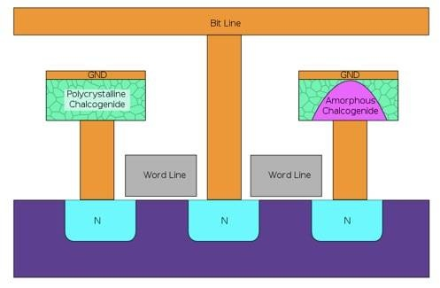
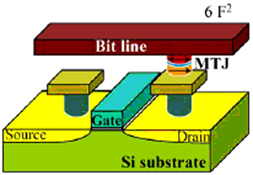
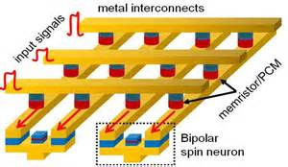
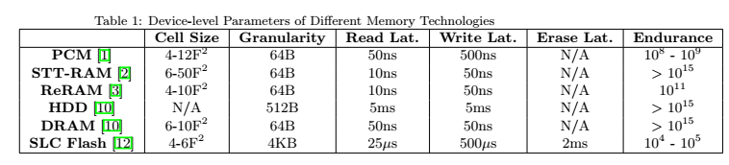
Emerging NVM Technology
PCM
STT-RAM
ReRAM
Key Features
Byte addressability
Comparable access speed as DRAM

Slide 4
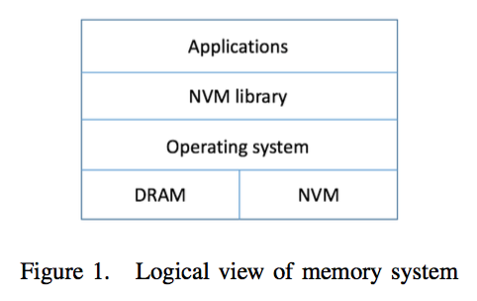
NVM in Memory System

Slide 5
Motivation for a New Allocator for NVM
Big data era is calling for in-memory computing
In memory computing: all information is initially loaded into memory RAM
To support better real-time business intelligence
Memory Allocators have been a key component of system software, making a significant impact on system performance
The unique features of emerging NVM bring new opportunities for Memory Allocators:
Very high access speed
Wear Leveling issues
None of the current allocators can provide both an accurate wear-leveling policy and a good allocation performance simultaneously.

Slide 6
Motivation for a New In-Memory File System (Cont’)
There are a number of existing memory allocators for NVM, but they have limitations!
Larger number means poorer performance
Systems | Allocation performance | Wear-leveling | Total Memory Usage
NVMalloc | 1(not fast enough) | Support(not good enough) | high
nvm_malloc | 2 | N/A | high
pmemalloc | 3 | N/A | high
Wamalloc | Expected to be the best | Expected to be the best | Expected to be the best

Slide 7
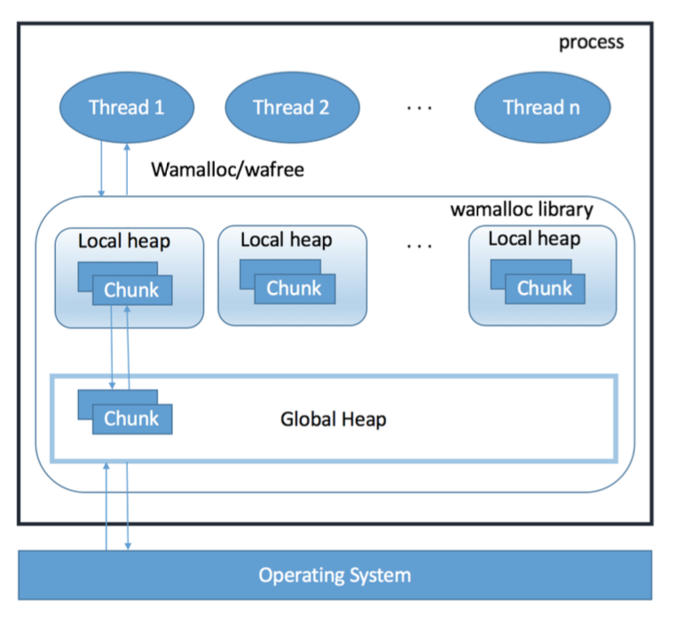
Design of Wamalloc
Desgin Principles:
Wear-leveling
Low allocation latency
Overall architecture

Slide 8
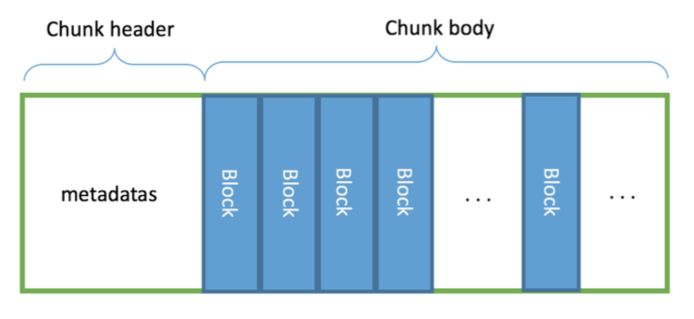
Design of Wamalloc
Chunk is the basic unit that would be transferred between global heap and local heap
Chunk can be divided into several blocks base on its size class
Chunk size has a fixed value to simply the design of global heap
Chunk Structure

Slide 9
Local Heap
Local heap is maintained by each thread, which stores information to find the appropriate chunk
Every memory chunk in the local heap can be classified into five categories:
in-use
full
waiting
not-available
clean

Slide 10
State Transition of Chunk

Slide 11
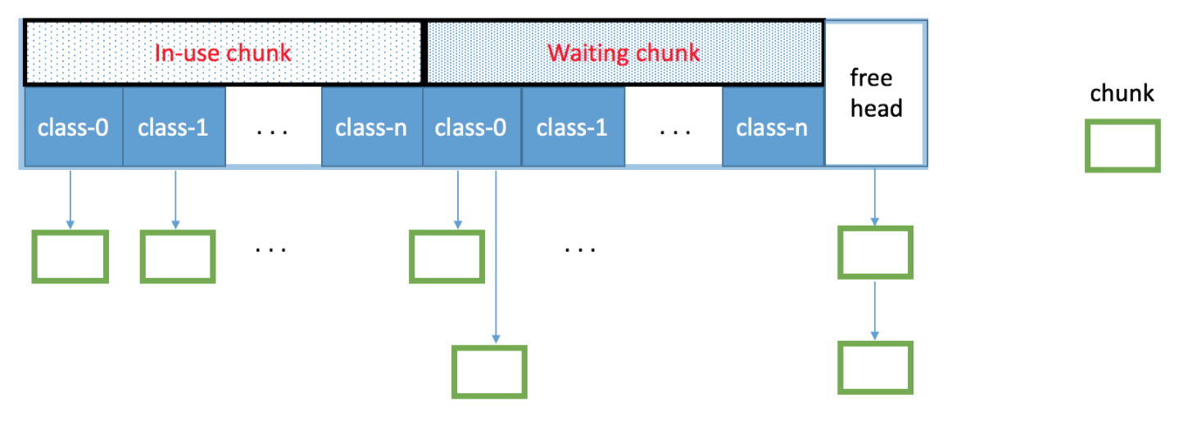
Local Heap Structure

Slide 12
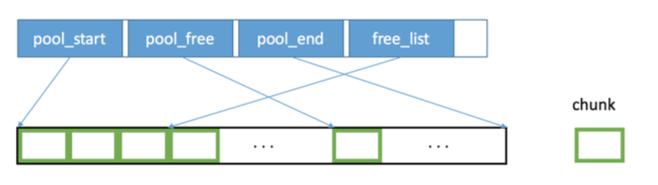
Global Heap
Global heap maintains the whole memory chunks obtained from operating system.
Global heap structure

Slide 13
Design of Wamalloc(Cont’)
Use different wear-leveling policy in different level:
In block level: FIFO queue is enough
In local heap level:
FIFO queue is enough
Use waiting chunk first, then clean chunk
Add a wear-aware count, if reaches threshold, then not available, ready to return to global heal
In global heap level :
A minheap is used to implement the priority queue to find the chunk of the minimum allocation time.
Chunks are not moved to global pool synchronously, instead, the real action is taken under the ground asynchronously
Notes:
在分配Chunk中的block时，遵循FIFO原则，但有个阈值W，若这个Chunk中的总分配数超过这个W，则无法再分配，变为not-available chunk
在分配空间Chunk时，同样遵循FIFO。
在global heap中分配时，用了以下两条策略。

Slide 14
Allocation/Deallocation Algorithm of Wamalloc
Allocation policy:
use size get the size class, then use the size class current find the in-use chunk to allocate block
if full, then look for a waiting/clean chunk
otherwise ask for chunk from global heap
Deallocation policy:
put the memory block into per-chunk list
If clean, then move the chunk to clean list

Slide 15
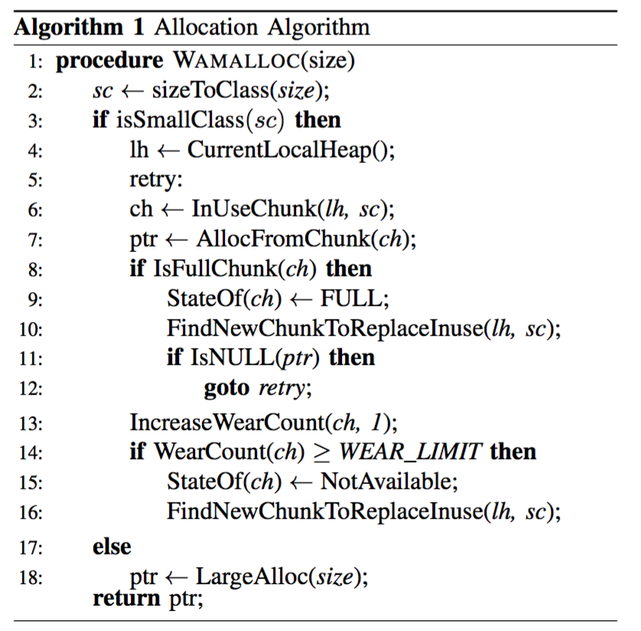
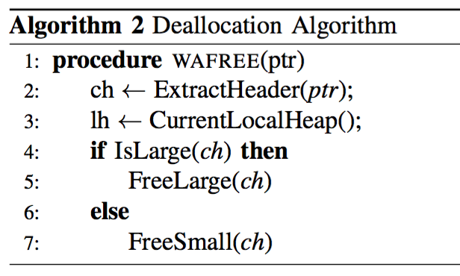
Pseudocode of Wamalloc

Slide 16
Evaluation
We have implemented Wamalloc and evaluated its performance on:
wear-leveling against NVMalloc
allocation performance against NVMalloc and glibc
total memory usage against NVMalloc

Slide 17
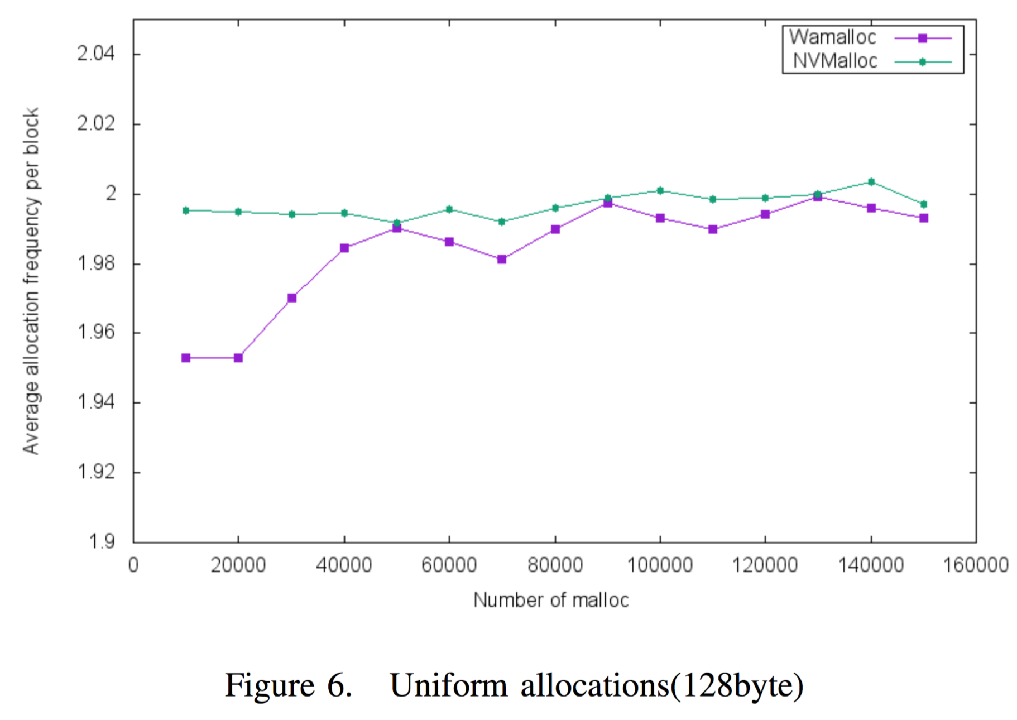
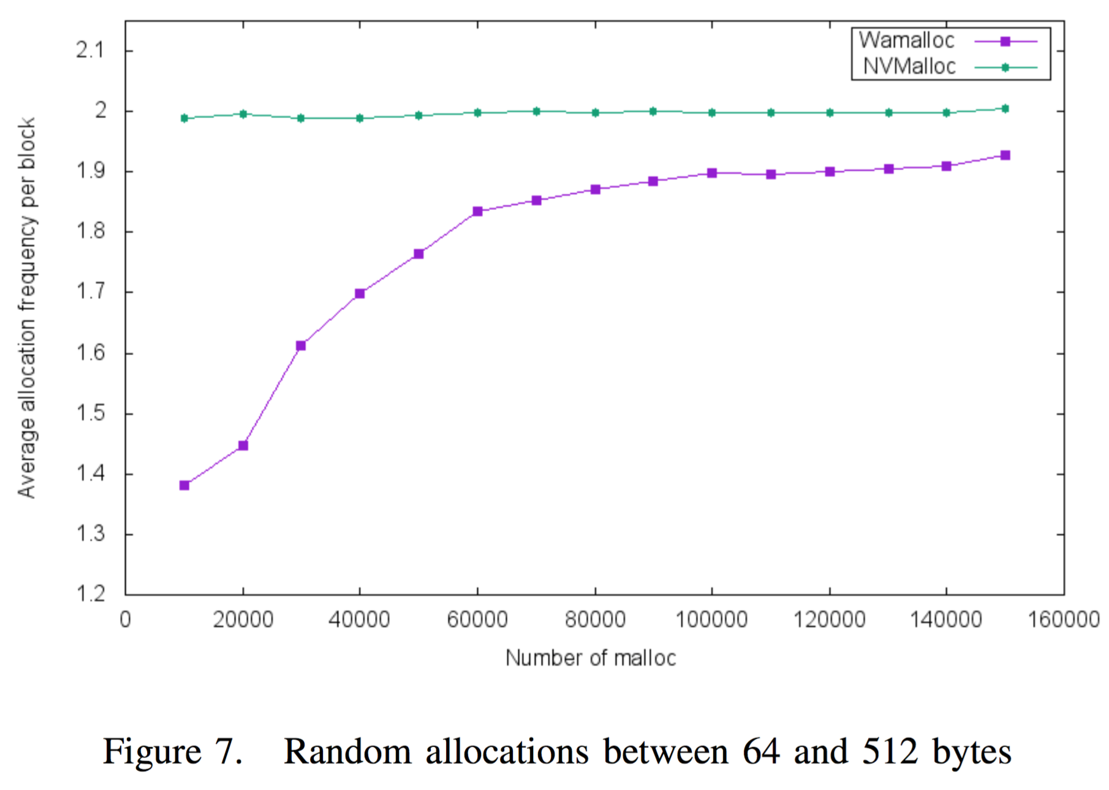
wear-leveling
Wamalloc outperforms other memory allocators

Slide 18
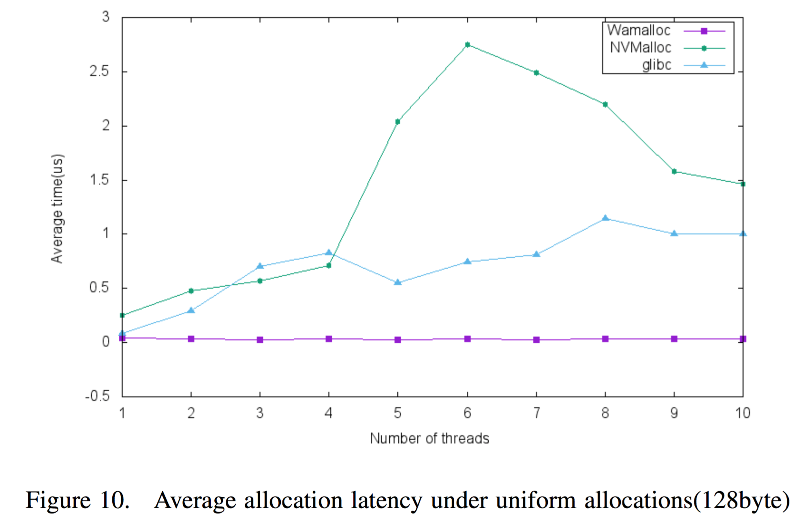
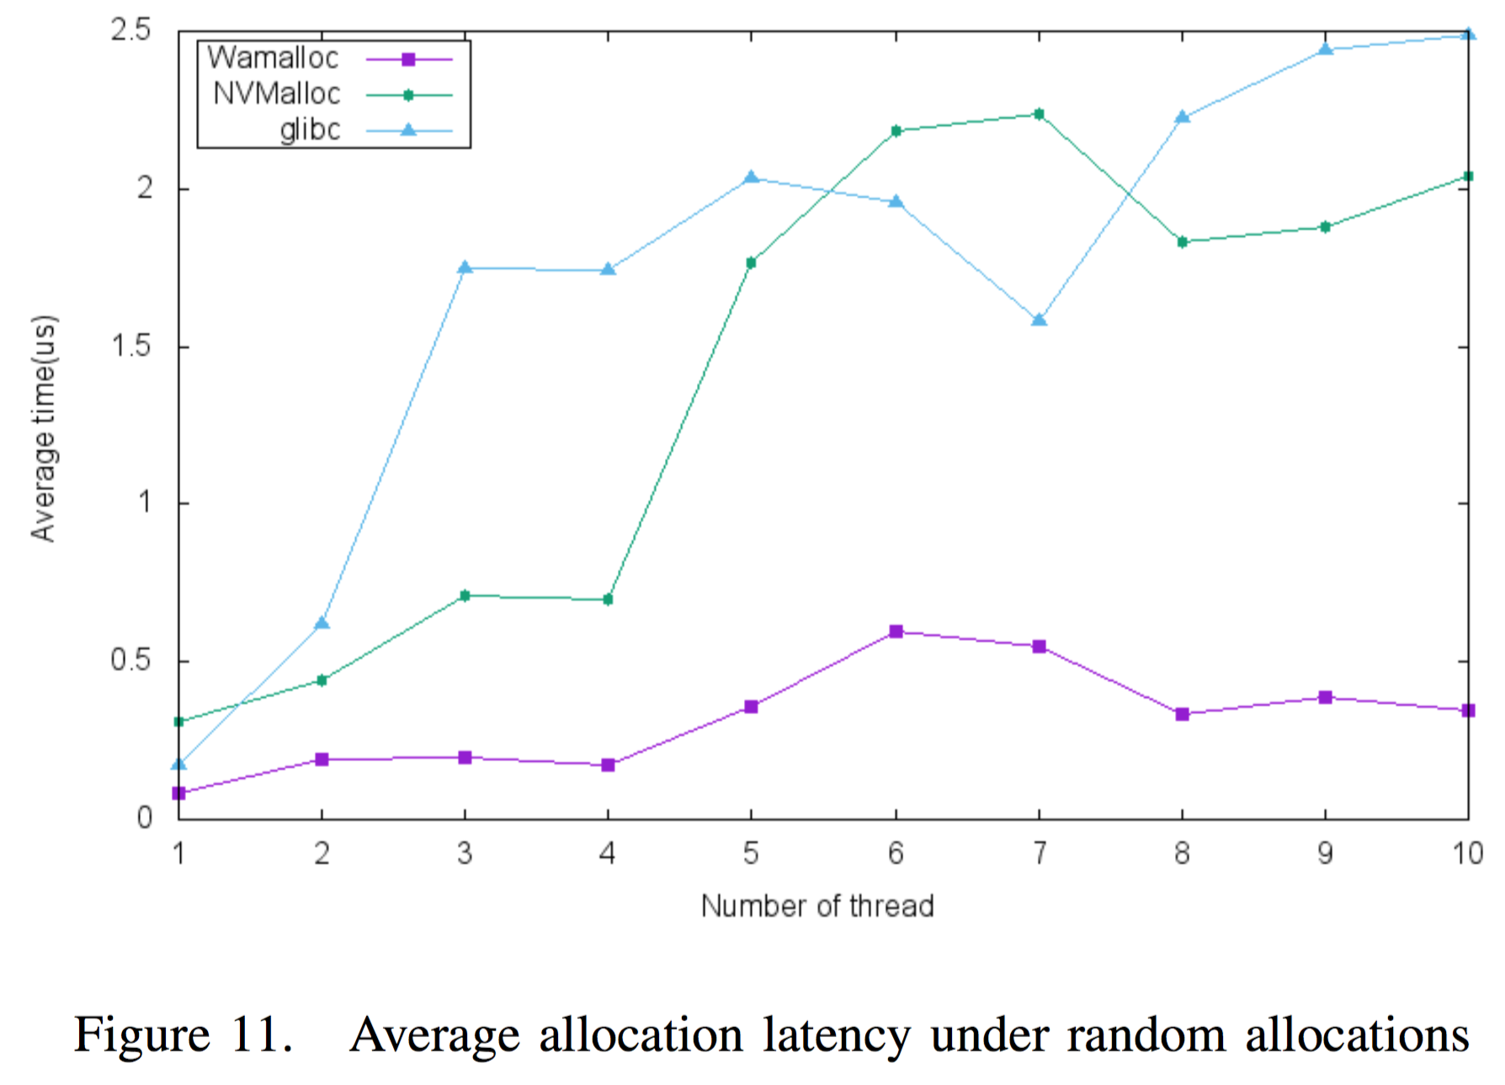
allocation performance
Wamalloc outperforms other memory allocators

Slide 19
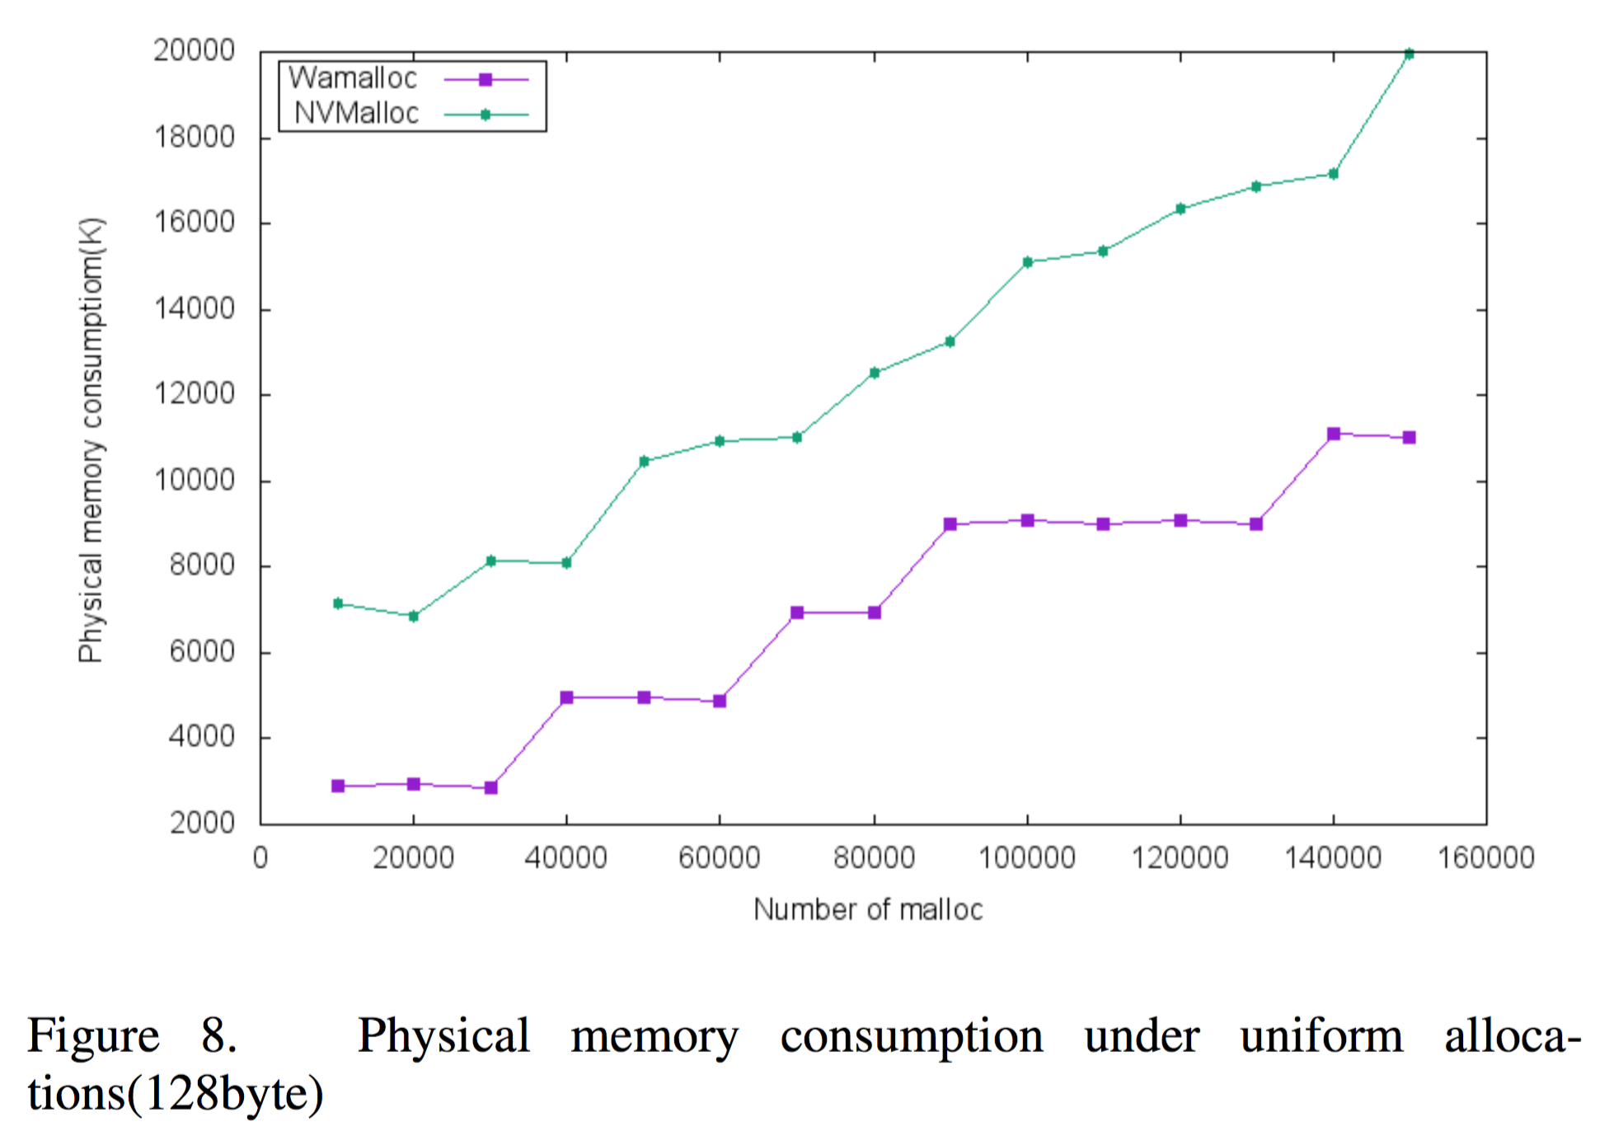
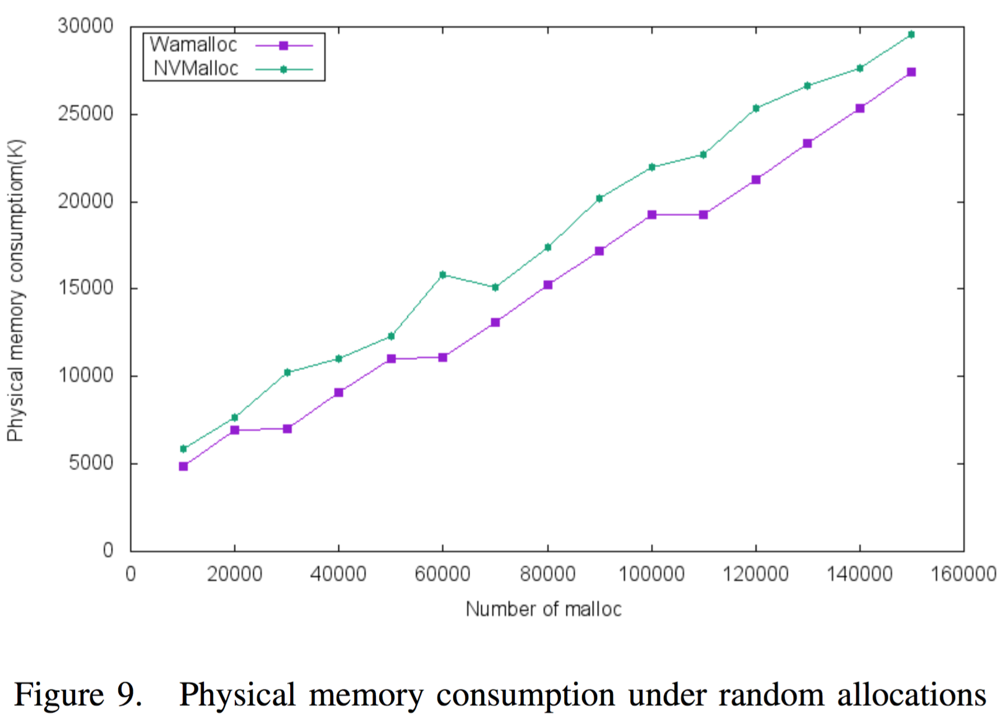
total memory usage
Wamalloc outperforms other memory allocators

Slide 20
Conclusion
In this paper, we observe the fact that no NVM allocators at the time of writing can provide both an accurate wear-leveling policy and a good allocation performance simultaneously.
Based on the observation, we propose an efficient wear-aware NVM allocator, Wamalloc, which uses a thread-cache memory architecture causing nearly no lock contention in critical path, and an elaborate hybrid wear-leveling policy to improve the lifetime of NVM.
The experimental results show that Wamalloc outperforms NVMalloc in terms of wear-leveling policy, total memory consumption and allocation performance.

Slide 21
Thank you
Q & A

